Slide 1




Cryptocurrency

Slide 2
Content
What is Cryptocurrency?
Origin of Cryptocurrency
Implementation of Cryptography and Block-Chain
Differences between Real money and Cryptocurrencies
Benefits and disadvantages of Cryptocurrency
Top 10 popular Cryptocurrencies in the market

Slide 3

What is Crypto-currency?
Cryptocurrencies are digital currency.
Verified by Cryptographic algorithms.
Based on a bigger concept - “Block-Chain”

Slide 4
Origin of Crypto-currency
In 1983, an American cryptographer David Chaum conceived an anonymous cryptographic electronic money called ecash.
The first decentralized cryptocurrency, bitcoin, was created in 2009 by pseudonymous developer Satoshi Nakamoto

Slide 5
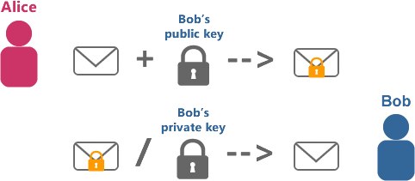
Cryptography
Every user gets 2 keys: a private & a public key
Verification of transactions by Hash functions
Cryptocurrency Mining

Slide 6
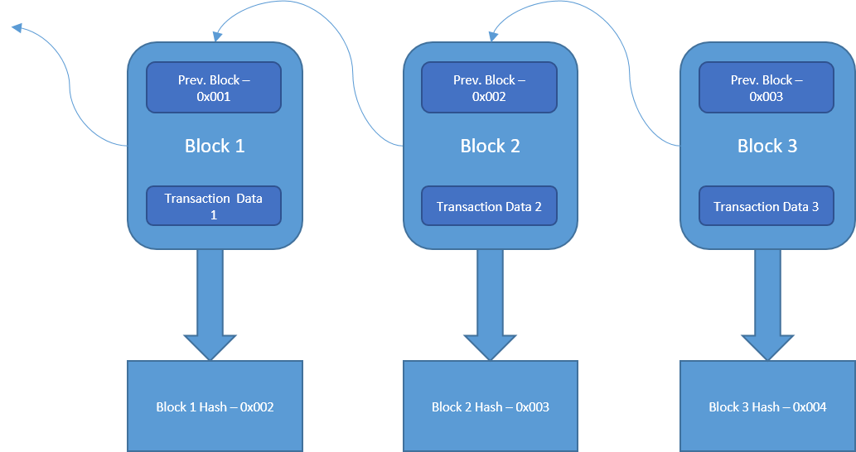
Block-Chain
Similarity to reverse linked list
Genesis Block
Global Ledger and its distribution

Slide 7


Real money v/s Cryptocurrency
Real Money
Cryptocurrency
Monitored by a Centralized Authority
Bank can generate money to control financial world
Un-anonymous transactions
Fees related with big transactions
No Centralized Authority
Finite number of cryptocoins
Anonymous transaction
No fees for transcation

Slide 8


Benefits & Disadvantages of cryptocurrency
Benefits
Disadvantages
Can’t be counterfeited and secured by Cryptography
Immediate transfer of coins.
Open to everyone
Globally available for same value
Lack of Knowledge
Difficulty to understand
Not accepted widely
No way to reverse payments
Volatity

Slide 9

Top 10 popular Crypto-currencies
BitCoin
Ethereum
LiteCoin
Monero
Ripple
Dodgecoin
Dash
MadeSafeCoin
Lisk
Storjcoin X

Slide 10
Thank You…

